Slide 1

NATIONALISM IN INDIA
NATIONALISM
IN
INDIA

Slide 2
CULTURAL FACTORS AND IDENTITIES WHICH CREATED A SENSE OF COLLECTIVE BELONGING AMONG THE PEOPLE OF INDIA.
IMAGE OF BHARAT MATA :
Bankim Chandra Chattopadhyay created the image of Bharat Mata.
Abanindranath Tagore painted her image.
Bharat Mata looked like a Sanyasini. She is calm, divine and spiritual. Devotion towards her became a proof of Nationalism.

Slide 3
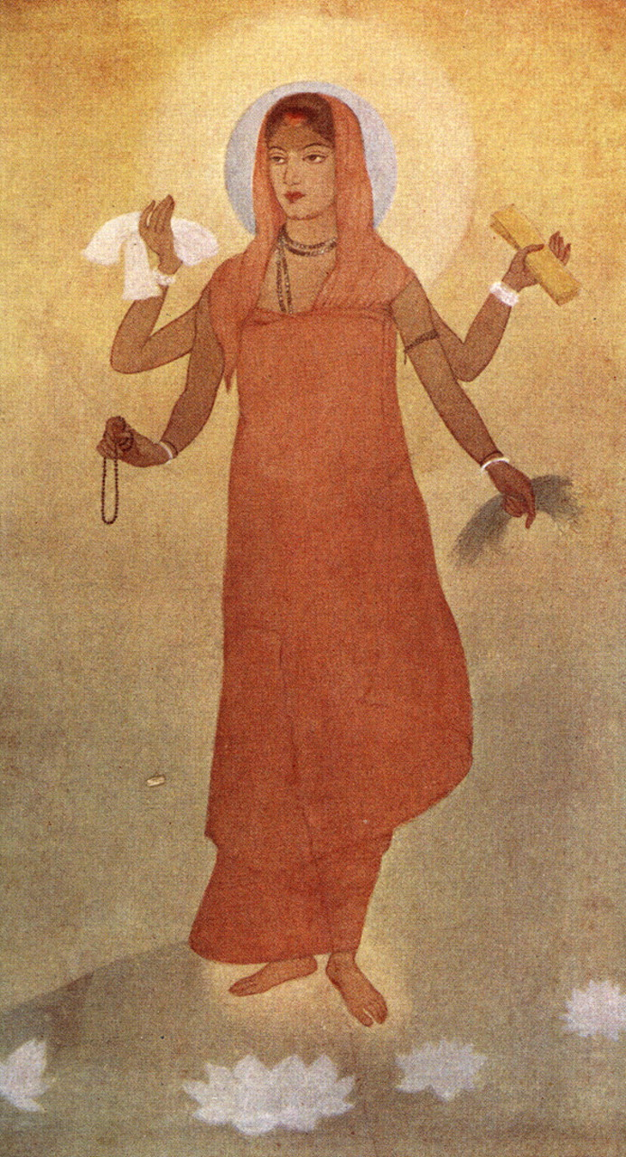
IMAGE OF BHARATMATA

Slide 4
VANDE MATARAM
It was a prayer to Bharat Mata written by Bankim Chadra Chattopadhyay.
Vande Mataram became the war cry of the Indians.
It was later included in his novel Anandamath

Slide 5
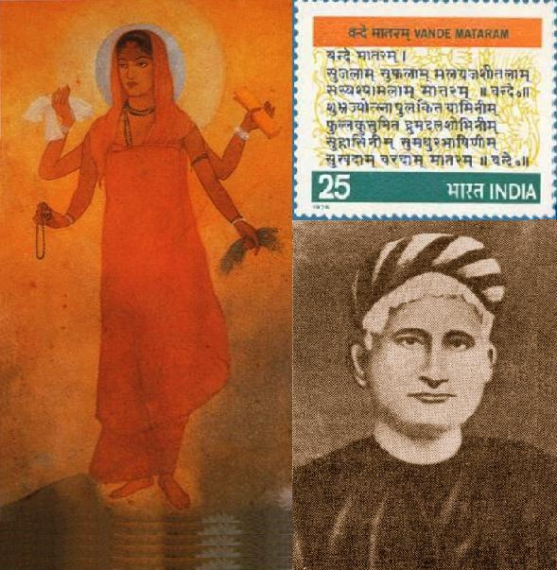
VANDE MATARAM

Slide 6
NATIONAL FLAG
During the Swadeshi Movement a tricolor flag (red, green and yellow) was developed. It had 8 lotuses representing the 8 provinces of the British India. It also had crescent moon which represented Hindus and Muslims.
In 1921, Gandhiji designed the Swaraj flag. It was also a tricolor flag (red, green and white). It had a spinning wheel which represent the Gandhian idea of Self Help.
The flag became a symbol of the Nation. It created the feeling of oneness. The people carried flag in protest marches and rallies

Slide 7

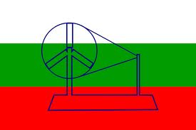
NATIONAL FLAG
SWADESHI FLAG SAWARAJ FLAG

Slide 8
REDISCOVERY OF INDIA’S PAST
The British considered Indians backward and primitive. They said that the Indians were not capable of ruling themselves.
In the 19th century, some educated Indians started the efforts of rediscover India’s great achievements. They rediscovered the achievements made by the Indians in art, architecture, science, mathematics, religion, culture, law, philosophy, crafts and trade.
Knowledge about the great achievements of Indians created national pride, self confidence and patriotism among the Indians.

Slide 9
REVIVAL OF FOLKLORE
Nationalists toured the villages to collect the folk songs and legends.
Rabindranath Tagore collected a number of folk songs and legends.
In Madras, Natesa Sastri published a four volume collection of tamil folk tales (The Folklore of Southern India).
The folk songs and legends gave a true picture of Indian culture. They showed there all thoughts and characteristics of Indians.
They created National Pride among the people.

Slide 10
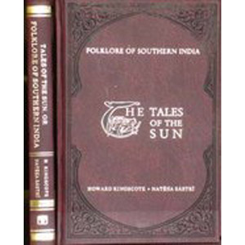
FOLKLORE OF SOUTHERN INDIA

